Slide 1
2025-2029 Financial Planning​ Core Services Electoral Area Services
500 Planning

Slide 2
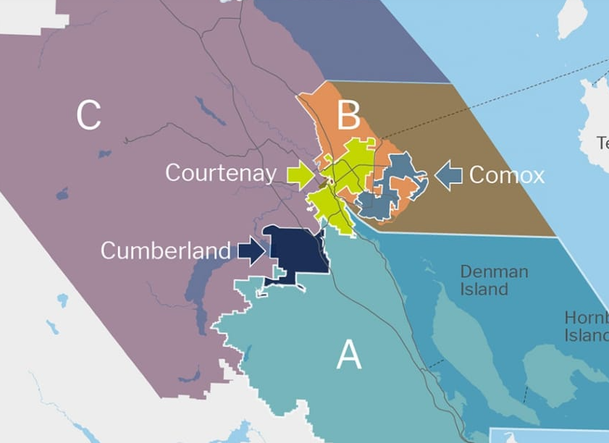
Core Service | Electoral Area Services
Service Name | Planning
Service Sub-functions​ | 501 – Planning – Geographic Info System 502 – Planning – Bylaw Enforcement 503 – Planning – Planning Policy
Purpose | Planning and land use management
Participants | Defined Portion of Electoral Area A, Electoral Areas B and C
2025 Proposed Changes to Service | None

Slide 3
2024 Accomplishments
124 planning applications in 2024
Implemented Bill 44, Housing Statute requirements
Enabling short-term accommodations rental on Mt. Washington
254 bylaw compliance files opened: 221 files closed
137 tickets issued through the Provincial Adjudication process
Royston Elementary MUP grant award and project underway
Home Energy Concierge Program/CleanBC Municipal Top-up Rebates
Coastal Flood Adaptation Strategy Phase 3– completion of collaborative framework
Completed Comox Valley Agriculture Plan update
Notes:
Implemented Bill 44 by amending the zoning to enable every residential lot to have two units without restriction
The CVRD was successful in receiving a BC Active Transportation Infrastructure grant in the spring of 2024 for Royston Road Elementary Multi-Use Path. Since then, staff have been working with consultants on preparation of detailed drawings with construction targeted for summer 2025.
The CVRD launched the Home Energy Concierge Program in January of 2025, supported by the Local Government Climate Action Program funding, in addition to participating in the CleanBC Municipal Top Up Rebate Program. Both program focus on energy transitions from fossil fuels to electric heat pumps in order to reduce community GHG emissions.
Staff have also been busy working on the third phase of the Coastal Flood Adaptation Strategy. With the collaborative framework process now complete, the project will focus on developing preferred mitigative measures for Comox Road. The CVRD is working very closely with K’omoks First Nation and based on interest from the nation, the CVRD has been successful in securing additional funds in order to provide additional resource support to the nation in order to ensure K’omok’s interests and priorities are captured.

Slide 4
Trends, Challenges and Opportunities​
Increase in Temporary Use Permit applications (e.g. Short-Term Rentals)
Planning and Building Service Delivery project (2025)
Review of regulatory framework to meet unique housing needs in rural areas
CityWorks Permitting, Licensing and Land Planning and Development project
Climate resiliency, disaster risk reduction, flood hazard management
Continuous need for collaboration, partnerships and engagement
Focus on community energy transitions/GHG reductions
Notes:
Angst and concern
Ever increasing need to engage and provide level of service
Integrating climate risk and adaption continues to be a critical in the development of planning tools and policies in order to increase resiliency to face major climate changes and mitigate such changes. Projects such as Floodplain Management Bylaw Update, CFAS and Saratoga LAP all incorporate a climate risk lens in scope and project deliverables.
Doing as much as we can to protect property owners. Make community as resilient as possible. Showcase resilient infrastructure such as Dyke Rd Park
Collaboration continues to be key in order to advance project initiatives to avoid duplication, create efficiencies and leverage resources and funding like with the Home Energy Navigator, where the CVRD has been successfully able to leverage LGCAP dollars to deliver a regional program, that supports residential fuel switching.
Strong advocacy role for elected officials, supporting the board and advising the board on where they can advocate
Challenges with other ministries when it comes to implementation (e.g. Royston Rd MUP). Trying to navigate it like public

Slide 5
Strategic Priorities and Initiatives ​
Type | Initiative | Comment
Electoral Areas Serv ices Committee | Undertake Agricultural Planning | New Position – AG Coordinator
Electoral Areas Services Committee | Development Approval Process Review | Procedures and Fees review; Service delivery project
Board | Implement the Active Transportation Network Plan | Royston Elementary MUP – construction Spring 2025
Notes:
Key reasons to new position. Idea for Year 1
More regulations – provincial. Hazard areas. Stay out of DP areas.
Active Transportation Network Plan implementation is underway with the first AT project in the electoral areas with the Royston Elementary MUP. Detailed drawing have been prepared. Staff have presented the drawings to Royston PAC and are planning an open house for the community in the spring. Construction is scheduled for summer 2025.

Slide 6
Human Resource ​​
 | 2025​ |  |  | 2026
 | Planning | GIS | Bylaw | Planning | GIS | Bylaw
Opening FTE Balance | 10.60 | 3.25 | 2.03 | 11.23 | 3.25 | 2.03
Addition Request​
Full time ​ | 1.00 |  |  | 1.00
Part Time ​
Temporary /Casual
Adjustments​ | -0.37
Total Change | .63 | 0.00 | 0.00 | 1.00 | 0.00 | 0.00
Ending FTE Balance | 11.23 | 3.25 | 2.03 | 12.23 | 3.25 | 2.03
Total Ending FTE | 16.51 |  |  | 17.51
Notes:
New Position –
In 2025, One full time position of Agricultural Plan Coordinator with 100% allocated to service #503, starting May 1, 2025
- In 2026, one full time position of Planning Technician with 100% allocated to service #500, starting Jun 1, 2026
Adjustments: Manager of IT Project (1060), 2024 FTE allocation 50%-500 50%-285; while 2025 FTE allocation 33%-500 33%-291 34%-285. Effective FTE in 2024 was 0.38 in 2025 was 0.33, so -0.05 decrease in 2025. FOR PLANNING SERVICE -17%
Branch Assistant-Planning & Development Services (1124) Tabitha Wall, 2024 FTE allocation 10%-119 20%-285 60%-500 10%-780) while in 2025 (10%-119 20%-285 20%-500 20%-503 20%-512 10%-780), allocation FTE decreased by -0.2 effective FTE decreased by -0.2 FOR PLANNING SERVICE – 0.20
.lw… check in - do we want to show the FTE separated ?

Slide 7
Total Service Expenses
Year over Year Change ​
Key Notes
 | 2024 Approved Budget | 2025 Proposed Budget | Increase (Decrease) ($) (%)
Support Services | $367,971 | $316,733 | ($51,238) | (13.9%)
Personnel Costs | 1,881,958 | 2,022,791 | 140,833 | 7.5%
Materials, Supplies & Utility | 243,466 | 154,770 | (88,696) | (36.4%)
Contract & General Service | 873,700 | 521,081 | (352,619) | (40.4%)
Minor Capital | 24,000 | 16,000 | (8,000) | (33.3%)
Transfer to Reserve | 15,000 | 38,024 | 23,024 | 153.5%
Transfer to Other Functions | 384 | 371 | (13) | (3.4%)
Total | $3,406,479 | $3,069,770 | ($336,709) | (9.9%)
Total budget down 9.9%
Notes:
90,000 city works
Grant– 2024 483,000 – some CF into 2025
Saratoga
ATPN

Slide 8
Planning Expenses (sub-function 500 & 503)
Year over Year Change ​
Key Notes
 | 2024 Approved Budget | 2025 Proposed Budget | Increase (Decrease) ($) (%)
Support Services | $242,693 | $216,493 | $26,200 | (10.8%)
Personnel Costs | 1,258,003 | 1,360,654 | 102,651 | 8.2%
Materials, Supplies & Utility | 122,503 | 60,835 | (61,668) | (50.3%)
Contract & General Service | 785,219 | 461,773 | (323,446) | (41.2%)
Minor Capital | 8,500 | 8,500 | - | -
Transfer to Reserve | - | 23,024 | 23,024 | 100.0%
Transfer to Other Functions | 20 | 51 | 31 | 155.0%
Total | $2,416,938 | $2,131,330 | ($285,608) | (11.8%)
CityWorks software [-60K], now in capital plan
Ministry of Housing grant funded expenses [-230.5K]
UBCM Flood Mitigation grant [-129.9K]
Notes:
Grant funding from UBCM for the CFAS Phase 3 will be carried forward as this project is ongoing until fall of 2025.
JS.. A lot of the items noted in the Key Notes will show as carry forwards in the recommended budget

Slide 9
GIS Expenses (sub-function 501)
Year over Year Change ​
Key Notes
 | 2024 Approved Budget | 2025 Proposed Budget | Increase (Decrease) ($) (%)
Support Services | $94,532 | $63,273 | ($31,259) | (33.1%)
Personnel Costs | 370,572 | 390,917 | 20,345 | 5.5%
Materials, Supplies & Utility | 79,500 | 81,500 | 2,000 | 2.5%
Contract & General Service | 11,000 | 2,000 | (9,000) | (81.8%)
Minor Capital | 13,000 | 5,000 | (8,000) | (61.5%)
Transfer to Reserve | 15,000 | 15,000 | - | -
Total | $583,604 | $557,690 | ($25,914) | (4.4%)
Ortho photos [-9K], every other year

Slide 10
Bylaw Expenses (sub-function 502)
Year over Year Change ​
Key Notes
 | 2024 Approved Budget | 2025 Proposed Budget | Increase (Decrease) ($) (%)
Support Services | $30,746 | $36,967 | $6,221 | 20.2%
Personnel Costs | 253,383 | 271,220 | 17,837 | 7.0%
Materials, Supplies & Utility | 41,463 | 12,435 | (29,028) | (70.0%)
Contract & General Service | 77,481 | 57,308 | (20,173) | (26.0%)
Minor Capital | 2,500 | 2,500 | - | -
Transfer to Other Functions | 364 | 320 | (44) | (12.1%)
Total | $405,937 | $380,750 | ($28,187) | (6.2%)
CityWorks Software [-30K] – moved to capital
Legal fees reduced [-20K]

Slide 11
Revenue ​
Year over Year Change ​
Key Notes
 | 2024 Approved Budget | 2025 Proposed Budget | Increase (Decrease) ($) (%)
Grants in Lieu | $7,500 | $7,500 | - | -
Government Grants | 483,442 | - | ($483,442) | (100.0%)
Taxation | 2,300,000 | 2,620,000 | 320,000 | 13.9%
Sale of Services | 74,200 | 72,150 | (2,050) | (2.8%)
Recoveries | 16,620 | 16,620 | - | -
Transfer from Reserve | 151,833 | 353,500 | 201,667 | 132.8%
Prior Year Surplus | 372,884 | - | (372,884) | (100.0%)
Total | $3,406,479 | $3,069,770 | ($336,709) | (9.9%)
2024 Grant revenue [-483.4K]
Reserve withdrawal increased to temper requisition increase
Notes:
Kelly – reserve transfer reduce requisition

Slide 12
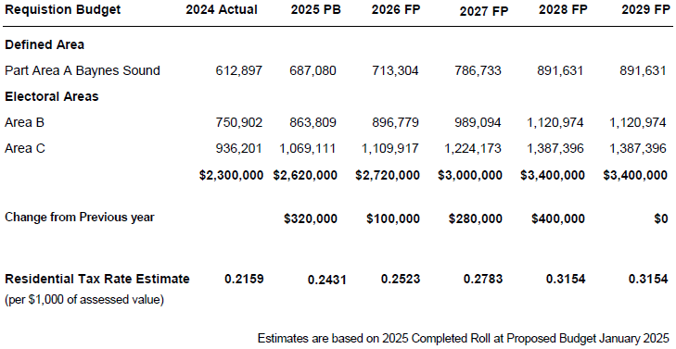
Funding Sources​
Tax Requisition ​

Slide 13
Operating Budget: 2026-2029 Projections​
Category | 2026 | 2027 | 2028 | 2029
Taxation | $2,720,000 | $3,000,000 | $3,400,000 | $3,400,000
Sale of Services | 73,150 | 72,150 | 73,150 | 72,150
Grants-in-lieu | 7,500 | 7,500 | 7,500 | 7,500
Recoveries from Other Functions | 16,620 | 16,620 | 16,620 | 16,620
Transfer from Reserve | 156,303 | - | 1,464 | -
Total Revenue | $2,973,573 | $3,096,270 | $3,498,734 | $3,496,270
Support Services | $316,733 | $316,733 | $316,733 | $316,733
Personnel Costs | 2,133,688 | 2,211,649 | 2,292,521 | 2,376,399
Materials, Supplies & Utilities | 171,866 | 172,463 | 168,563 | 168,660
Contract & General Services | 321,924 | 310,280 | 682,649 | 338,008
Minor Capital | 14,000 | 22,000 | 14,000 | 14,000
Transfer to Other Services | 362 | 335 | 321 | 207
Transfer to Reserve | 15,000 | 62,810 | 23,947 | 282,263
Total Expenses | $2,973,573 | $3,096,270 | $3,498,734 | $3,496,270

Slide 14
500 Planning​
2025-2034 Capital Planning​

Slide 15
2025-2029 Capital Plan ​
 | 2025 | 2026 | 2027 | 2028 | 2029
Vehicle Capital Purchase | - | - | - | $40,000 | -
Provision for GIS Server Upgrades | $8,000 | $20,000 | $8,000 | 8,000 | -
CityWorks Implementation | 340,000 | 40,000 | - | - | -
Total | $348,000 | $60,000 | $8,000 | $48,000 | -

Slide 16
Reserves ​
Projected Balances
Reserve | 2024 Ending Balance
500 – Planning Future Expenditure Reserve | $1,061,058
501 – GIS Future Expenditure Reserve | 102,044
850 – Planning Service Capital Works Reserve | 83,837
Total | $1,246,939

Slide 17
Planning F/E Reserve​ (#500)
Projected Balances
 | 2025 | 2026 | 2027 | 2028 | 2029
Opening Balance | $1,061,058 | $497,558 | $301,255 | $308,255 | $313,791
Add: Contributions to Reserve | - | - | 7,000 | 7,000 | 7,000
Less: Transfers from Reserve | 563,500 | 196,303 | - | 1,464 | -
Ending Balance | $497,558 | $301,255 | $308,255 | $313,791 | $320,791

Slide 18
Planning GIS Reserve​ (#501)
Projected Balances
 | 2025 | 2026 | 2027 | 2028 | 2029
Opening Balance | $102,044 | $109,044 | $104,044 | $111,044 | $118,044
Add: Contributions to Reserve | 15,000 | 15,000 | 15,000 | 15,000 | 15,000
Less: Transfers from Reserve | 8,000 | 20,000 | 8,000 | 8,000 | -
Ending Balance | $109,044 | $104,044 | $111,044 | $118,044 | $133,044

Slide 19
Planning Capital Works Reserve (#850)​
Projected Balances
 | 2025 | 2026 | 2027 | 2028 | 2029
Opening Balance | $83,837 | $106,861 | $106,861 | $147,671 | $109,618
Add: Contributions to Reserve | 23,024 | - | 40,810 | 1,947 | 260,263
Less: Transfers from Reserve | - | - | - | 40,000 | -
Ending Balance | $106,861 | $106,861 | $147,671 | $109,618 | $369,881

Slide 20
Summary
Fiscal Responsibility | Climate Crisis & Environmental Stewardship & Protection | Community Partnerships | Indigenous Relations | Accessibility, Diversity, Equity & Inclusion
Seek grant opportunities to offset impact on requisition | Coastal flood mitigation and adaptation to build resiliency Energy efficiency initiatives to mitigate GHGs | Ongoing partnerships with member municipalities and K'ómoks Project alignment and coordination | Ongoing partnerships with K'ómoks and First Nations | Inclusive process for community

Slide 21
Options & Recommendations​
That the proposed 2025-2029 financial plan for the Service 500 Planning be approved.

Slide 22
Questions?

